Slide 1

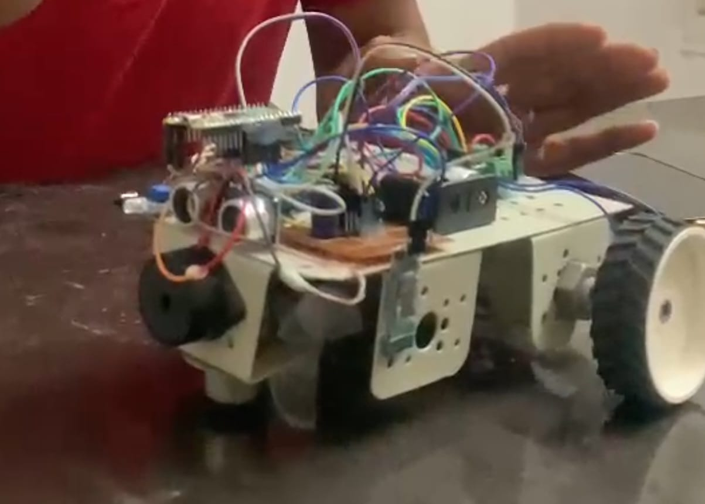
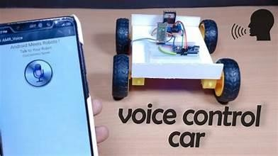
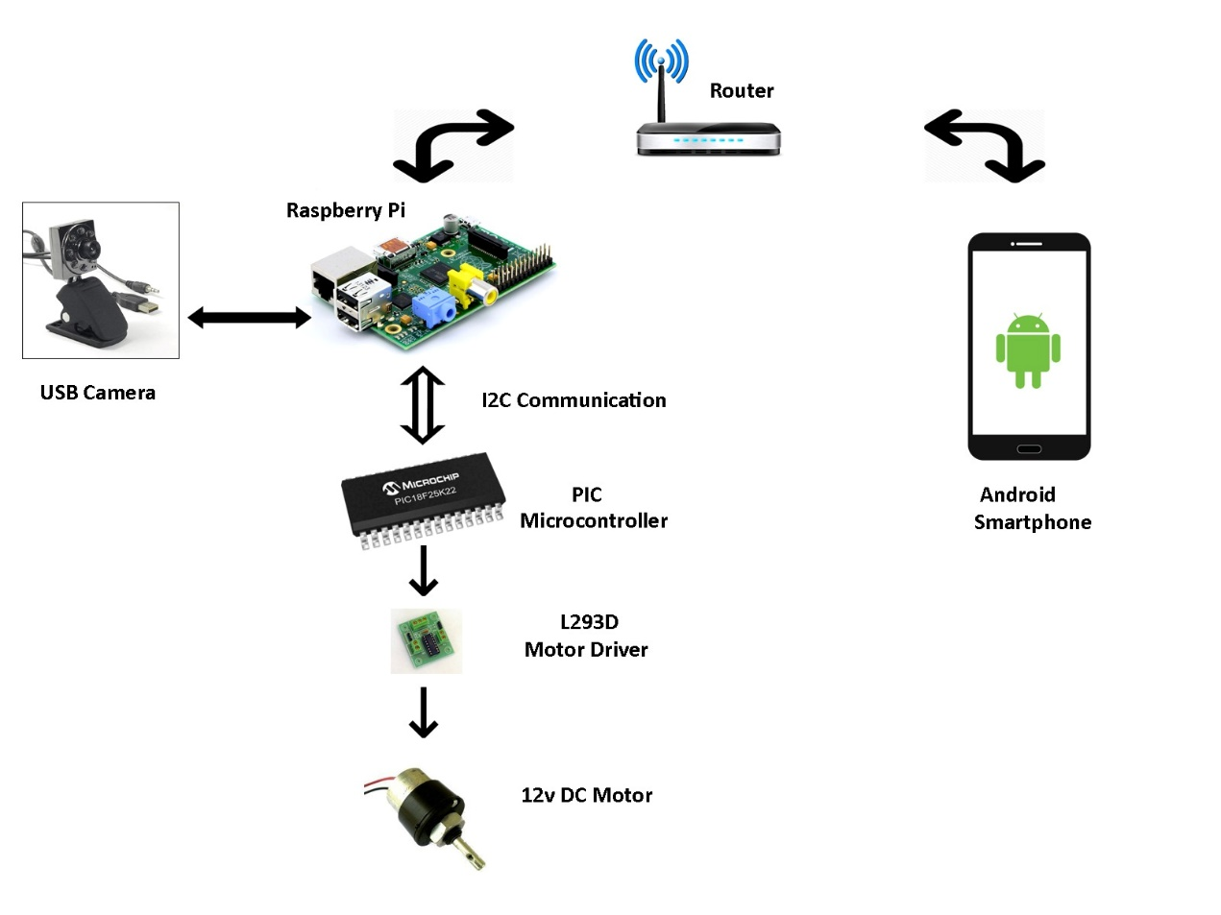
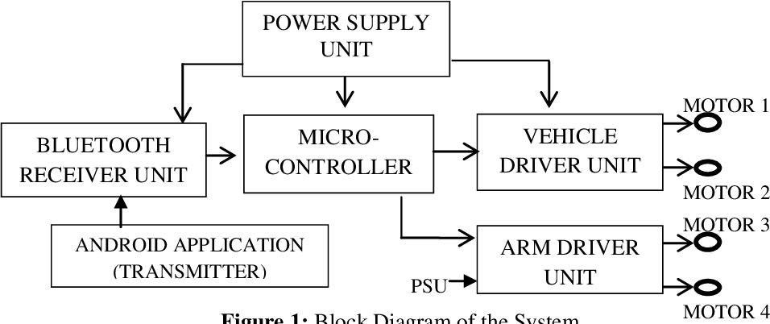
DEPARTMENT OF CSE (ARTIFICIAL INTELLIGENCE AND MACHINE LEARNING)
WIRELESS VOICE CONTROLLED ROBOTIC CAR USING RASPBERRY PI PICO
ABSTRACT
The voice-controlled robotic framework enables remote control of a robotic vehicle using voice commands received via an Android device. Raspberry Pi is integrated into the system to process the commands and operate the vehicle's motors accordingly. Any Android smartphone can act as the controlling device through a dedicated application for transmitting commands. Commands from the Android device dictate the vehicle's movements in forward, backward, right, or left directions. Raspberry Pi coordinates motor operations based on received commands, facilitating precise control of the robotic vehicle. This project showcases the fusion of voice recognition technology, Android applications, and Raspberry Pi microcontrollers to create an intuitive and efficient robotic control system.
RESULT SCREEN
SYSTEM ARCHITECTURE
CONCLUSION
The wireless voice-controlled robotic car project using Raspberry Pi Pico effectively integrates IoT technology and speech recognition to create an interactive robotic system. By utilizing motor drivers, wireless communication modules, and speech recognition algorithms, this project demonstrates the practical application of advanced technologies in robotics, highlighting its potential for user-friendly and innovative solutions.
UNDER THE GUIDANCE OF:-
Mr. S. Jayanna
(Assistant Professor)
BATCH NO: 5
Ch. Prabandana
G. Tvisha
M. Sai Supriya
O. Akshaya

